Slide 1

DriverPass System Analysis
Liu, Kevin

Slide 2

System Requirements
Functional Requirements:
Include analytical tools to track student progress, participation rates, and performance trends. Generate customizable reports for instructors and administrators to make data-driven decisions.
Students will have easy access to school events and the ability to plan out their schedule for programs, classes, and events.
Nonfunctional Requirements:
Adequate storage solutions must be implemented to accommodate the database and website data within the application.
Users must be provided with a mechanism to reset their password in the event of forgetting it.
Notes:
This requirement addresses the need for DriverPass to monitor and assess student performance, participation rates, and trends over time. By incorporating analytical tools into the LMS, DriverPass can gather data on student engagement and achievement, enabling instructors and administrators to make data-driven decisions to improve educational outcomes.
This requirement ensures that students have easy access to information about school events, programs, classes, and schedules within the LMS. By providing students with a centralized platform to view and plan their activities, DriverPass promotes organization and engagement, enhancing the overall learning experience.
With the vast amount of data generated by student progress tracking, event scheduling, and other functionalities, DriverPass requires robust storage solutions to ensure scalability, performance, and data integrity.
By providing a user-friendly password reset feature, DriverPass enhances usability and accessibility, reducing the risk of users being locked out of their accounts due to forgotten passwords.

Slide 3
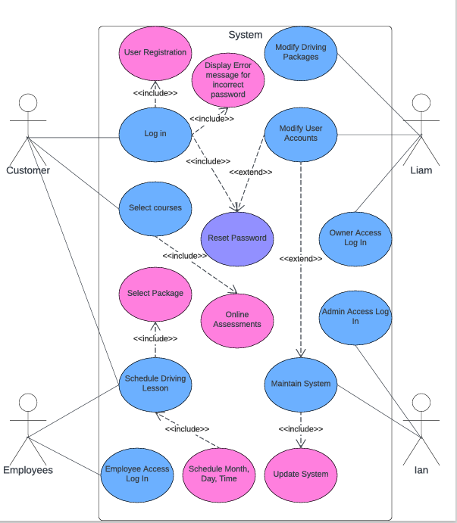
Use Case Diagram
[Insert your use case diagram here.]
Notes:
Customer, employees, Liam, Ian are described in this system. Customer can log in and select the courses they desire before being taught by an employee. The employee can see the time of the scheduled lesson and package the customer requested. Ian has admin access and can maintain the system and update it when needed. Liam has owner access and can modify accounts.

Slide 4
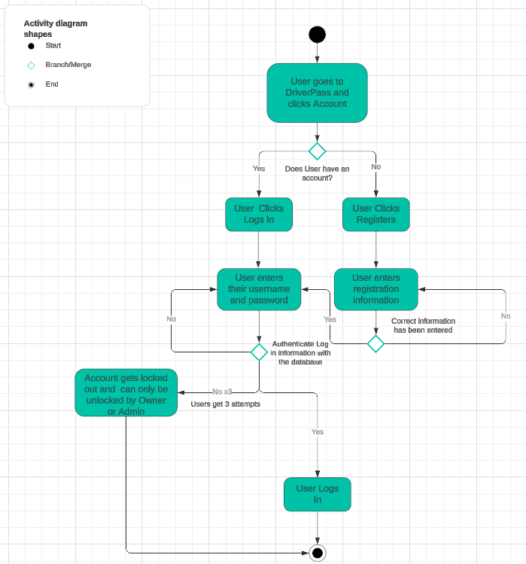
Activity Diagram
[Insert one of your activity diagrams here.]
Notes:
User goes to the DriverPass website and accesses their account. Users will attempt to log in with their username and password, but if they never had an account they can register for an account. After the User attempts 3 log ins without any success the account will be locked and can only be unlocked by the admin or the owner. Otherwise, if the log in is correct they will be able to log in successfully.

Slide 5
Security
The user will require to register their email and set a username and password to log in.
Users will also require having a device that is able to connect to the internet such as a computer system, or mobile device.
Implement encryption protocols, data masking techniques, and secure data storage practices to protect sensitive information.
Brute force hacking attempts will be stopped at the 3rd wrong input with account lockout and CAPTCHA as security measures to stop it.
Users that forget their password may get a password reset link through their email with a time limitation and security questions to verify their identity before allowing them to reset their password.
Notes:
In designing the system, security was a top priority. To ensure that only authorized users can access the system, we've implemented a registration process where users need to provide their email address, set a username, and create a password. This helps prevent unauthorized access to sensitive information.
To protect sensitive information, we've implemented encryption protocols, data masking techniques, and secure data storage practices. These measures help safeguard user data from unauthorized access or interception by malicious actors.
For users who forget their passwords, we've implemented a secure password reset process. Users can request a password reset link through their registered email address. Before allowing the password to be reset, users must verify their identity through security questions and adhere to a time limitation on the reset link. This helps ensure that only the rightful account owner can reset their password.

Slide 6
System Limitations
The initial implementation of the LMS system may require a significant number of resources for development, customization, and training.
LMS design and functionality may evolve over time based on user feedback and technological advancements.
Notes:
One limitation of the initial design of the LMS system is that it may require a considerable number of resources for its development, customization, and training. This means that it could be quite costly and time-consuming to set up and get running smoothly.
Another limitation is that the design and features of the LMS may not be perfect right from the start. Just like any new technology, there may be areas where it falls short or doesn't fully meet the needs of its users. This could lead to frustration or dissatisfaction among those using the system.
Overall, while an LMS can be a valuable tool for education and training, it's important to be aware of these limitations and be prepared to address them as they arise.

